Slide 1

IoT based Biometric Attendance System
Ashutosh Mohapatra (211020003)
Flavia Saldanha (211021007)

Slide 2
Purpose & requirements
Purpose:
An IoT-based attendance system using fingerprint authentication to log student entry and exit times, stored in Google Sheets and Firebase.
Records entry/exit times for each fingerprint scan. Calculates presence/absence and attendance percentage over time.
Requirements:
Manages student data (name, ID, email) in Firebase for secure access and retrieval.
Calculates each student’s attendance percentage based on recorded entries.
Cloud-based deployment on Firebase, with future integration for mobile data entry.
Uses secure data transfer between ESP32, Firebase, and Google Sheets.

Slide 3
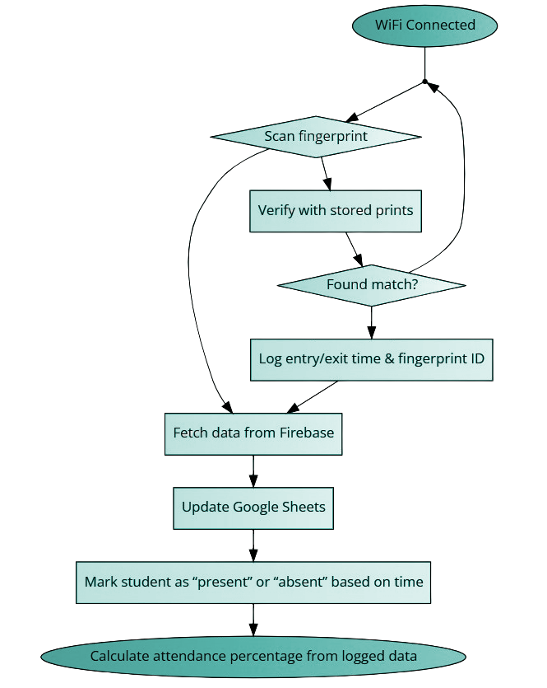


Process Specification
NO
student-data.json
YES
Mobile
App

Slide 4
Domain Model Specification
Physical Entity | Student: Attributes include name, registration ID, and fingerprint ID. Fingerprint Sensor: Captures biometric data for identification.
Virtual Entity | Firebase: Stores student details. Google Sheets: Logs attendance timestamps and updates details.
Device | ESP32: Communicates fingerprints and timestamps to Google Sheets.
Resource | On-device Resources: Fingerprint sensor and processing on ESP32. Network Resources: Firebase (stores student data: name, email, ID, fingerprint ID) and Google Sheets (logs attendance timestamps and fetches student details from Firebase).
Service | Fingerprint Authentication Service: Verifies fingerprints and sends data to Google Sheets. Attendance Logging Service: Records timestamps in Google Sheets. Cloud Sync Service: Syncs data between Google Sheets and Firebase for detail updates.

Slide 5
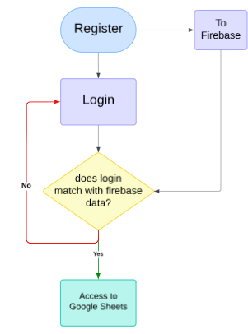
Information Model Specification
Data Structure:
Student Data: Stored in Firebase with name, email, registration ID, and fingerprint ID.
Attendance Log: Each entry in Google Sheets includes timestamp, fingerprint ID, and attendance status.
Data Flow:
The fingerprint ID from Google Sheets is cross-referenced with the Firebase database to populate student details.

Slide 6
Service Specifications
Fingerprint Authentication Service: Captures and verifies fingerprints via the ESP32 sensor.
Attendance Logging Service: Logs the entry/exit timestamps in Google Sheets.
Cloud Sync Service: Matches fingerprint ID in Google Sheets with student data from Firebase to retrieve and update student details.
Python Calculation Service: Calculates attendance percentage and updates status in Google Sheets.

Slide 7
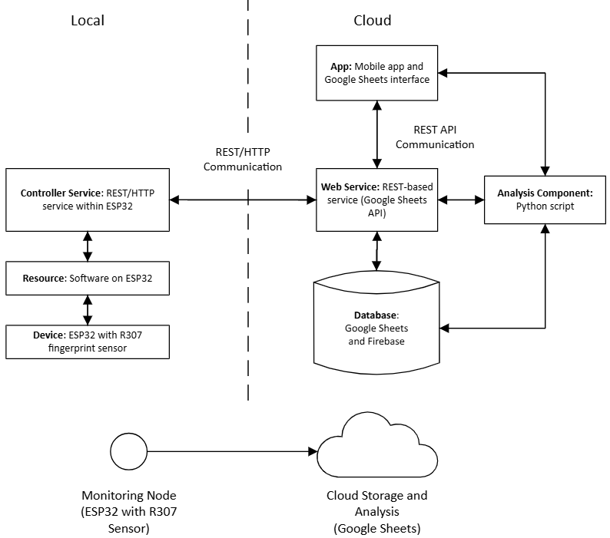
IoT Level Specification - IoT Level 3

Slide 8
Functional View Specification
Application
Management
Services
Security
Communication
Devices

Slide 9
Operational View Specification
Normal Operation: Fingerprint scans log times; attendance data syncs in real-time.
Error Handling: Wi-Fi connectivity issues prompt reconnection.
Maintenance: Add new student records in Firebase.
Application
Mobile App
Google Sheets Interface
Management
Services
Security
Admin Access to review attendance
Google Sheets
Firebase
Authentication
Communication
Database Management
Data Integrity
Google Sheets API
REST
Devices
Buzzer
ESP32
R307 Fingerprint Sensor
Display

Slide 10
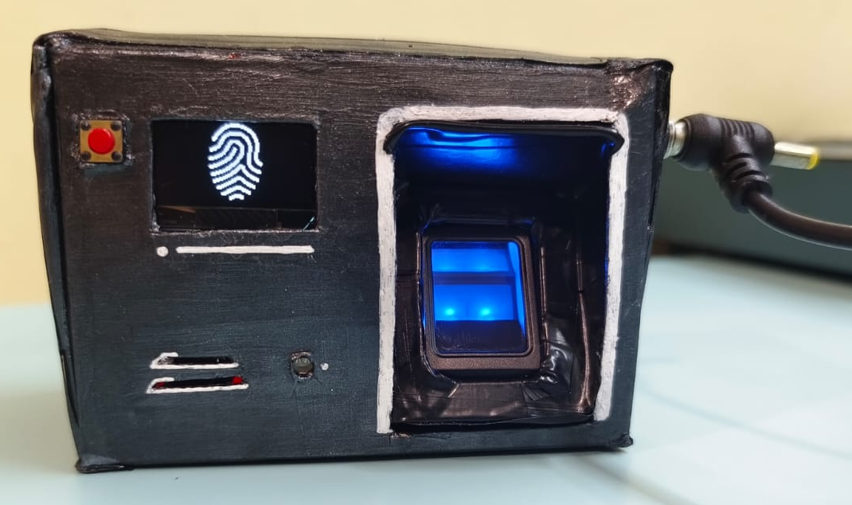
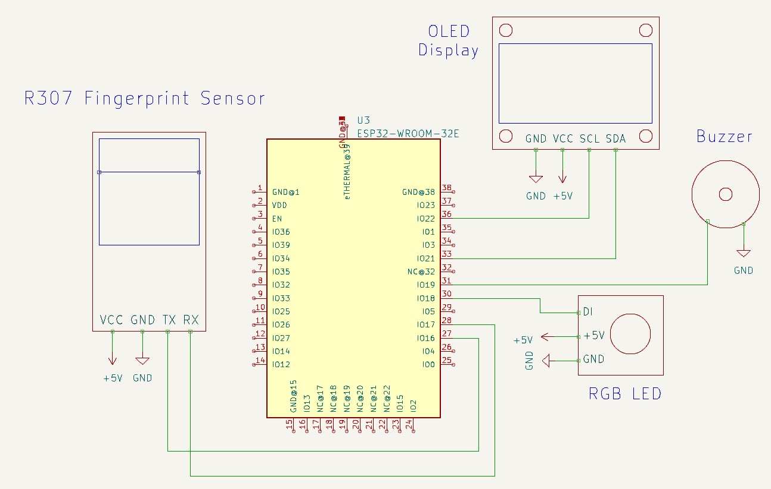
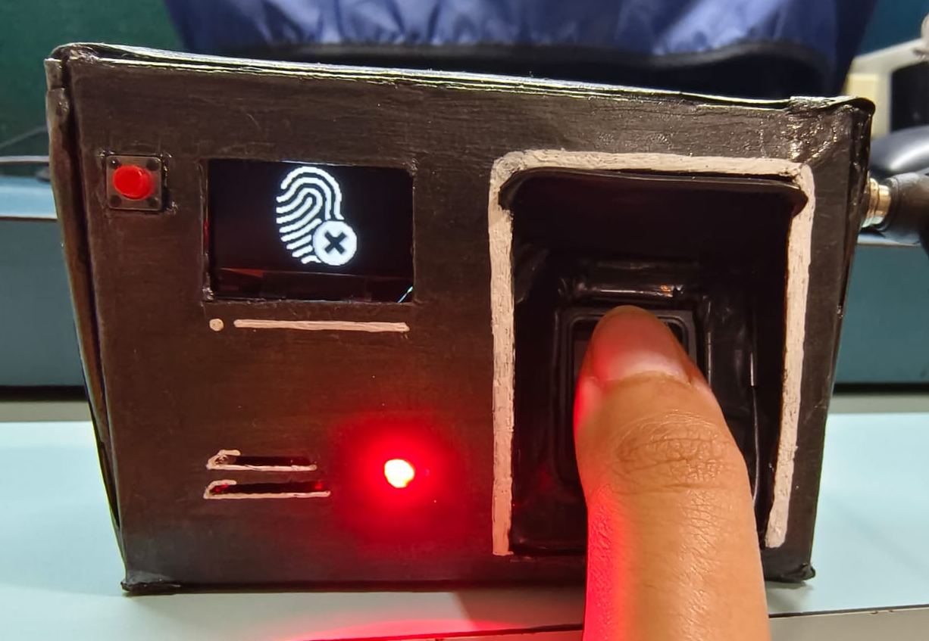
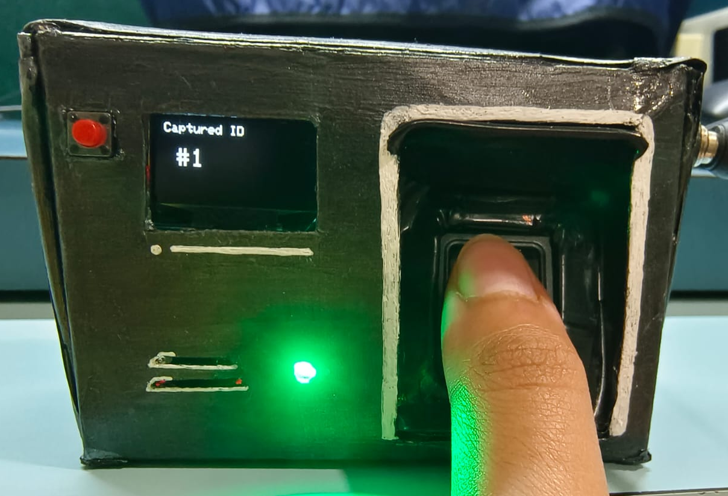
Device & Component Integration
ESP32: Interfaces with fingerprint sensor for biometric input.
Firebase: Central storage for student data.
Google Sheets: Manages attendance records, displaying data in a structured format.

Slide 11
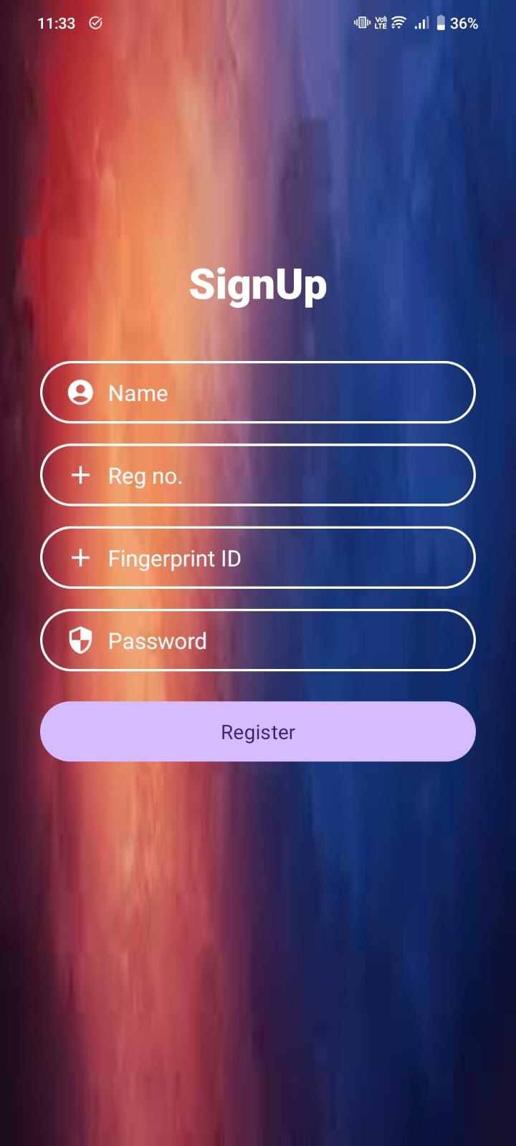
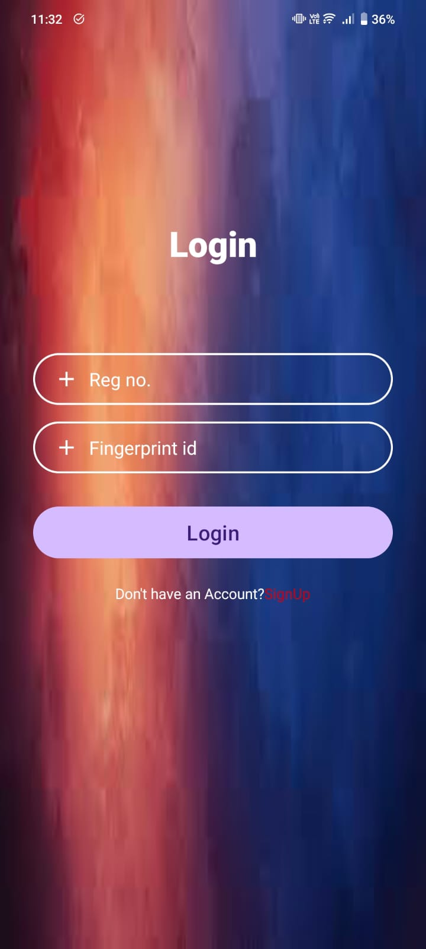
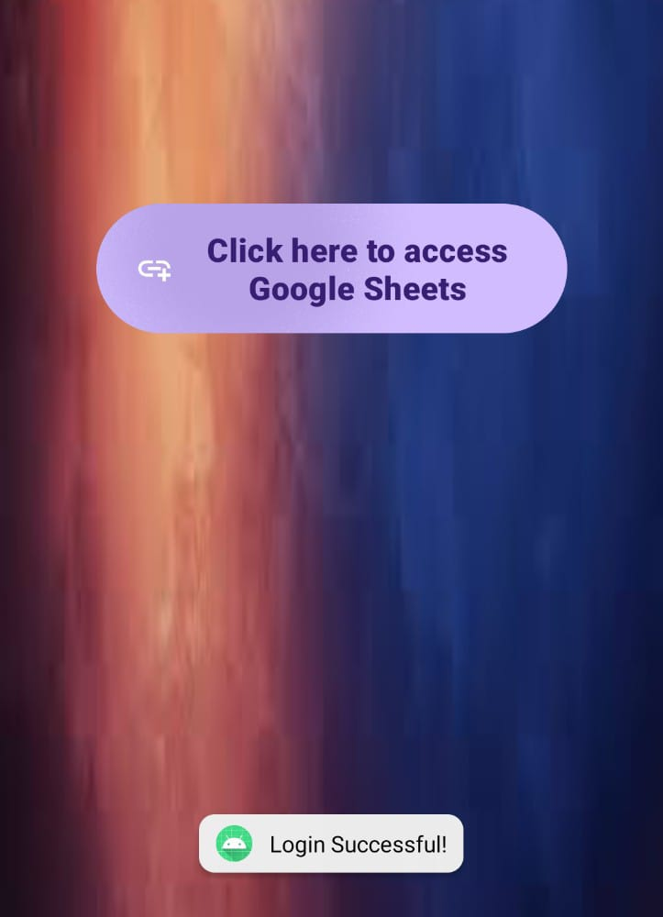
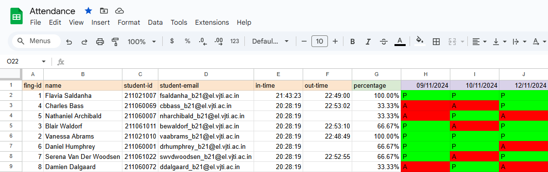
Application Development
Mobile App:
Purpose: Simplify student registration and attendance management.
Backend: Firebase manages data sync and storage.
Google Sheets:
Purpose: Stores attendance logs (fingerprint IDs, timestamps, attendance status).
Backend: Python Script to enter attendance status on a particular date and calculate overall attendance.

Slide 12
Thank You

